Slide 1

Segmentation Techniques:
Super Pixelization
& Region Growth
12.10.2024
Bret & Aiden
PHYS 510

Slide 2
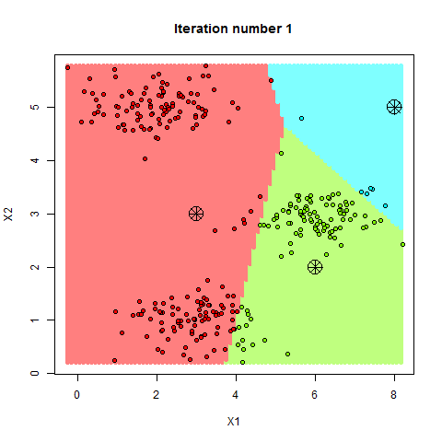
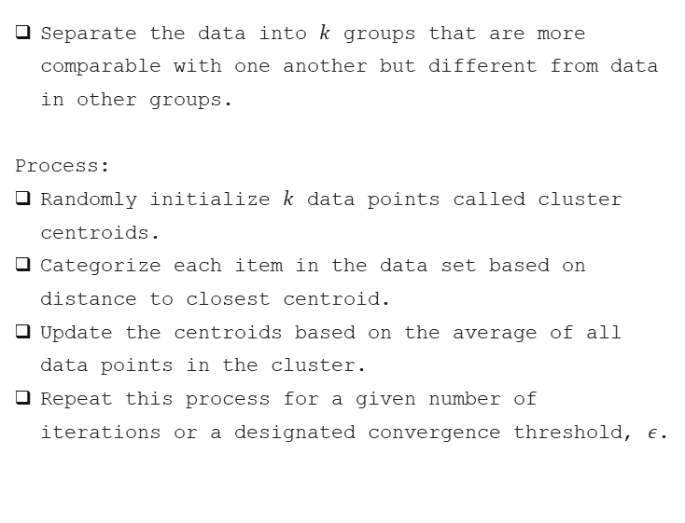
$k$-Means Clustering
Separate the data into $k$ groups that are more comparable with one another but different from data in other groups.
Process:
Randomly initialize $k$ data points called cluster centroids.
Categorize each item in the data set based on distance to closest centroid.
Update the centroids based on the average of all data points in the cluster.
Repeat this process for a given number of iterations or a designated convergence threshold, $ε$.
Sandipan Dey, 2023, https://sandipanweb.wordpress.com

Slide 3
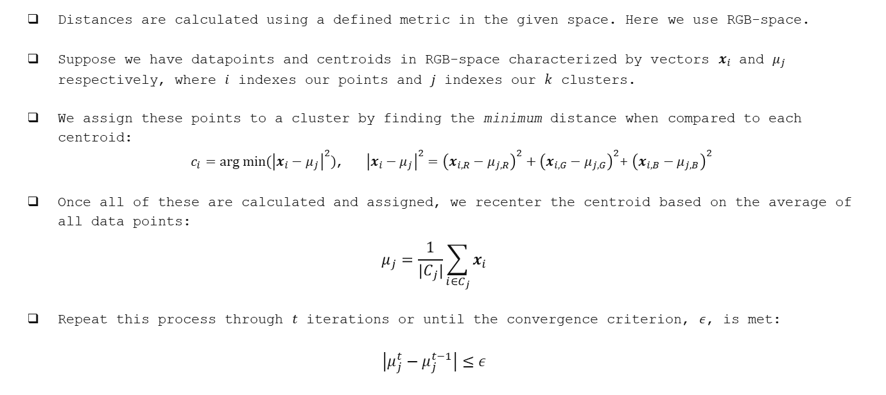
$k$-Means Clustering – ‘Distance’
Distances are calculated using a defined metric in the given space. Here we use RGB-space.
Suppose we have datapoints and centroids in RGB-space characterized by vectors $x_{i}$ and $μ_{j}$ respectively, where $i$ indexes our points and $j$ indexes our $k$ clusters.
We assign these points to a cluster by finding the minimum distance when compared to each centroid:
$c_{i}=arg min⁡({\left|x_{i}−μ_{j}\right|}^{2})$, ${\left|x_{i}−μ_{j}\right|}^{2}={\left(x_{i,R}−μ_{j,R}\right)}^{2}+{\left(x_{i,G}−μ_{j,G}\right)}^{2}$+ ${\left(x_{i,B}−μ_{j,B}\right)}^{2}$
Once all of these are calculated and assigned, we recenter the centroid based on the average of all data points:
$$μ_{j}=\frac{1}{{|C}_{j}|}\sum_{i∈C_{j}}{x_{i}}$$
Repeat this process through $t$ iterations or until the convergence criterion, $ε$, is met:
$$\left|μ_{j}^{t}−μ_{j}^{t−1}\right|≤ε$$

Slide 4
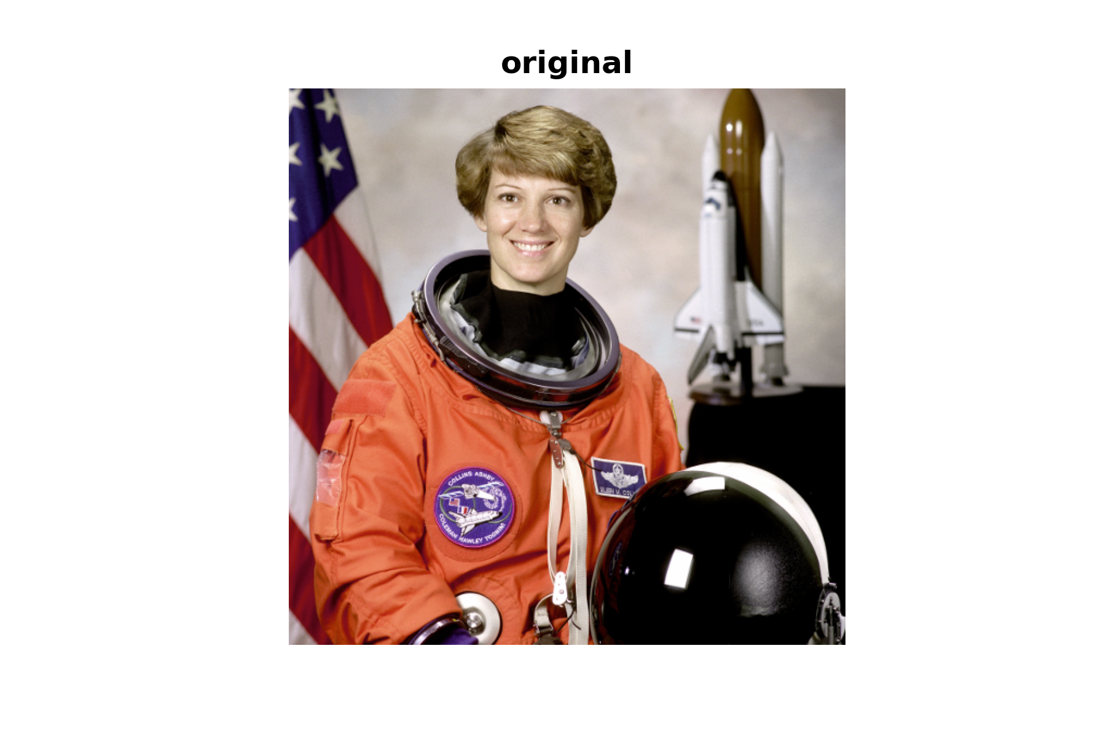
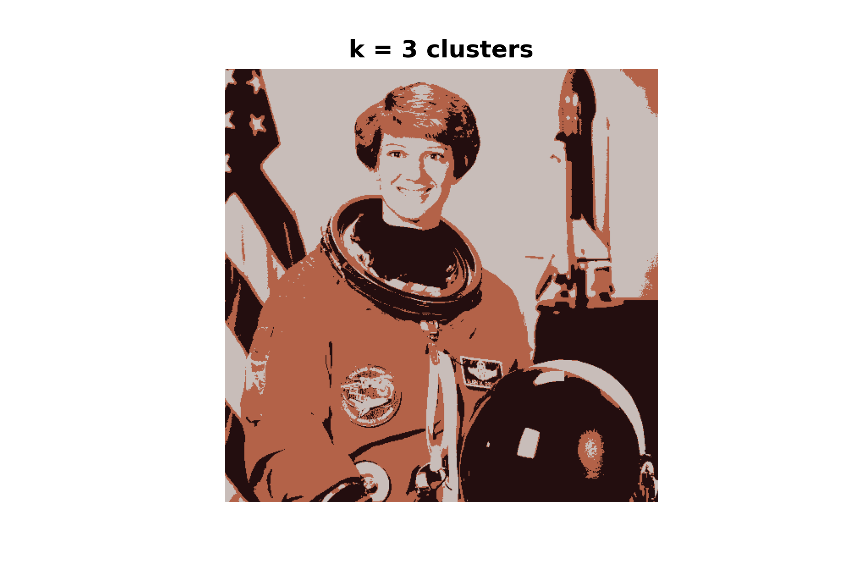
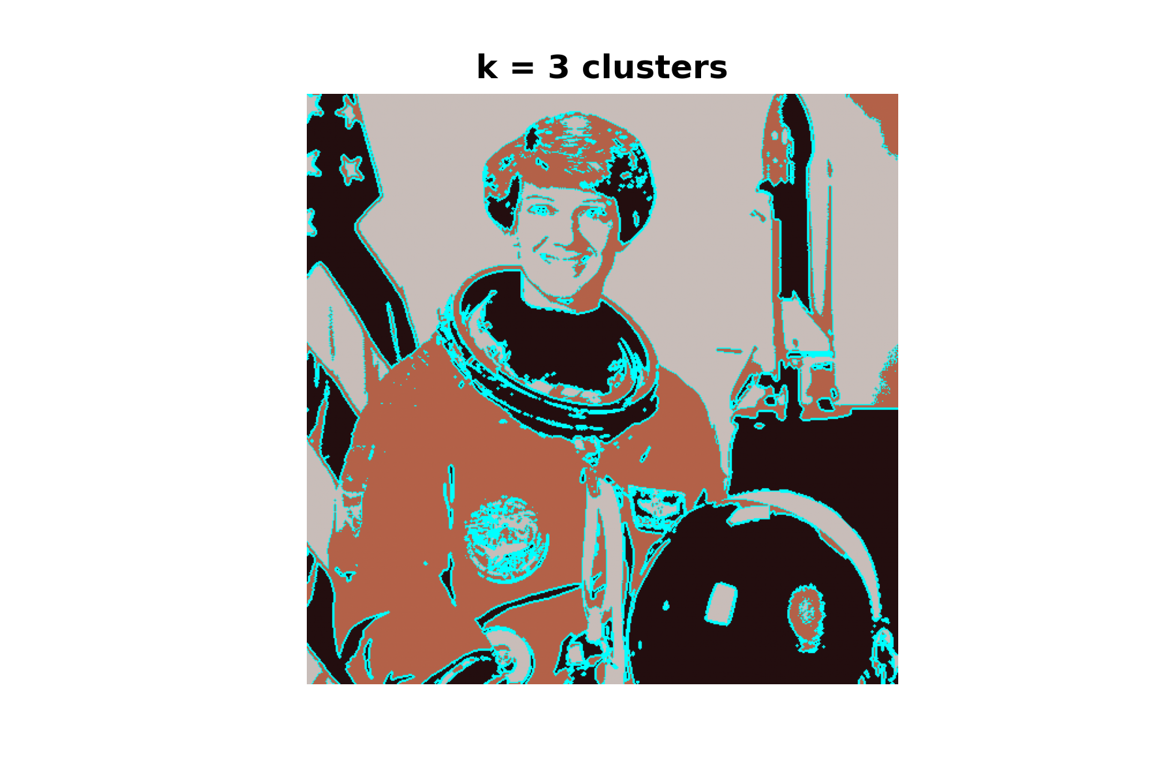
$k$-Means Clustering – Application

Slide 5
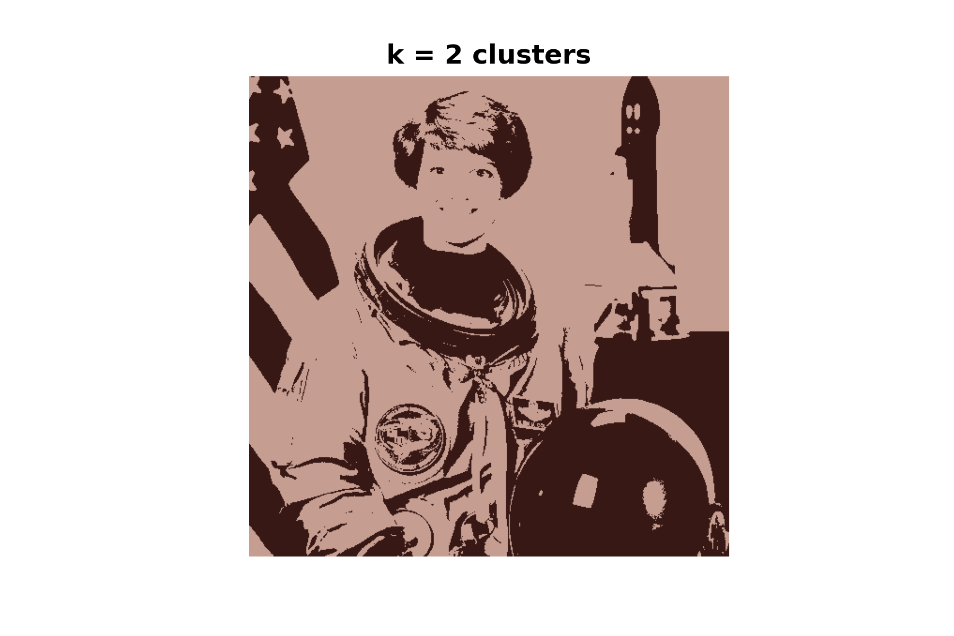

$k$-Means Clustering – Application

Slide 6

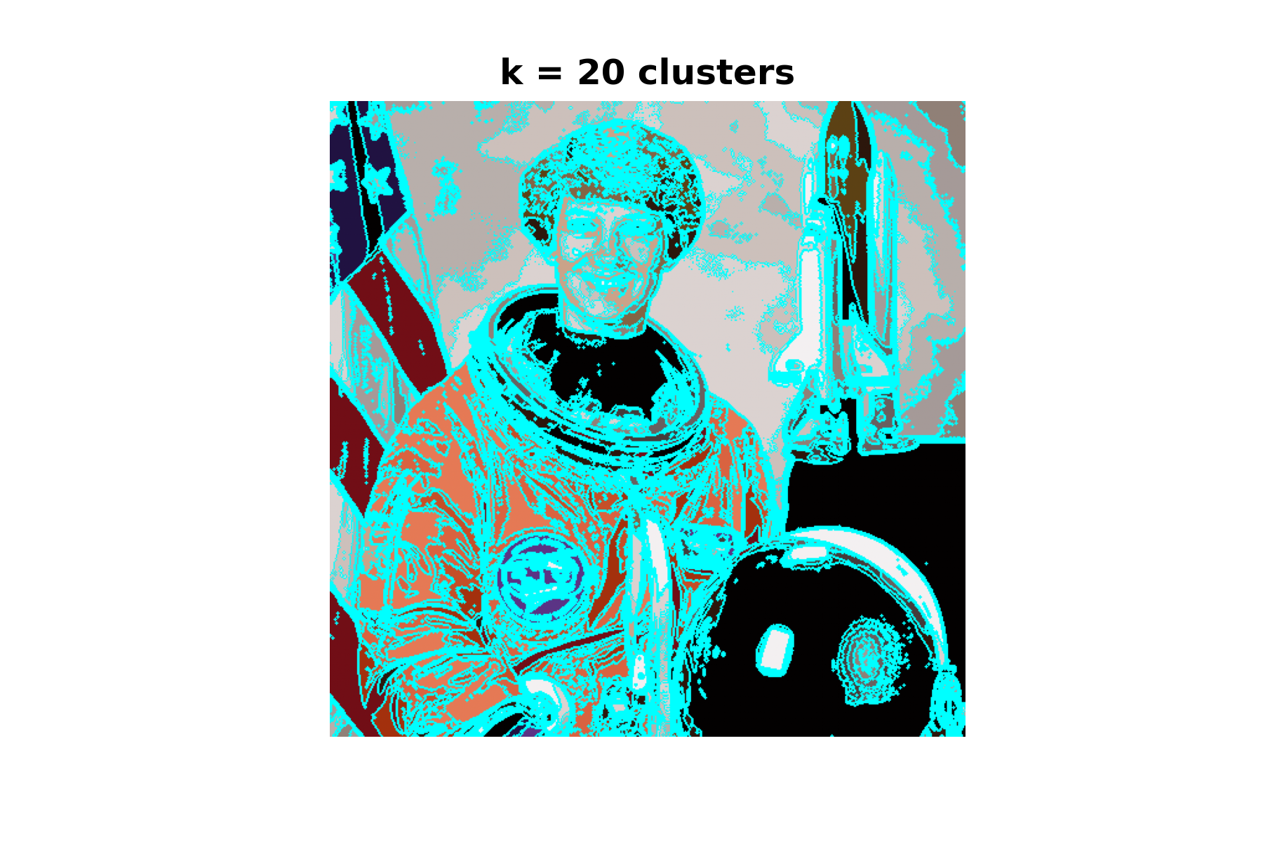
$k$-Means Clustering – Application

Slide 7
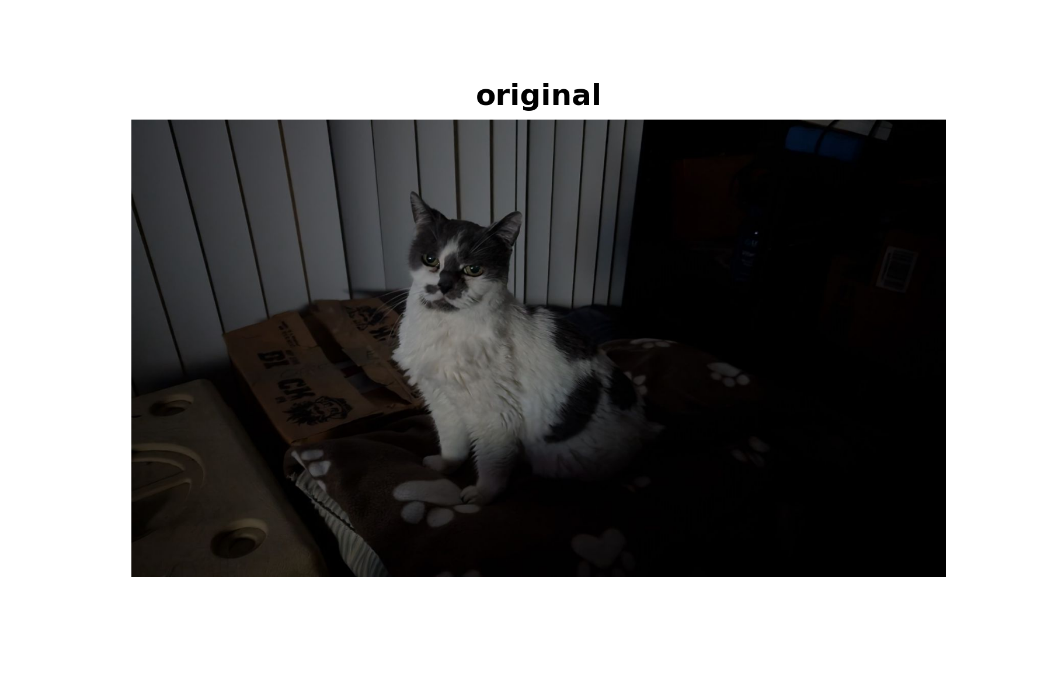
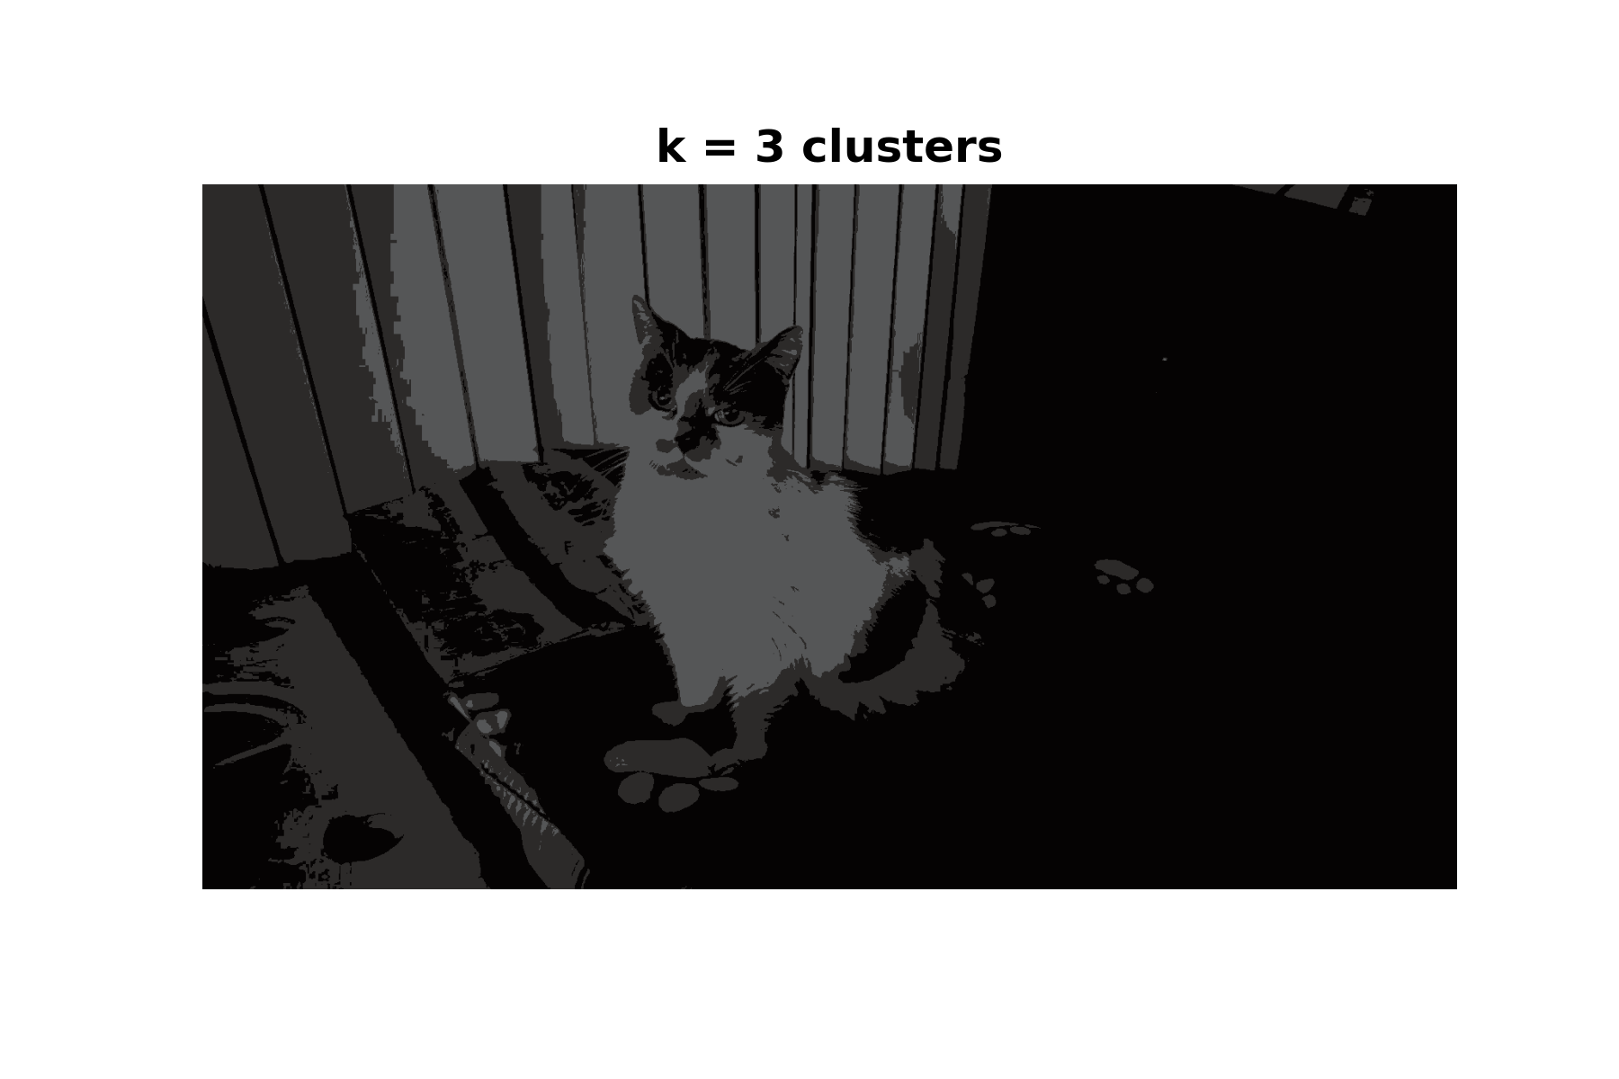
$k$-Means Clustering – Application

Slide 8
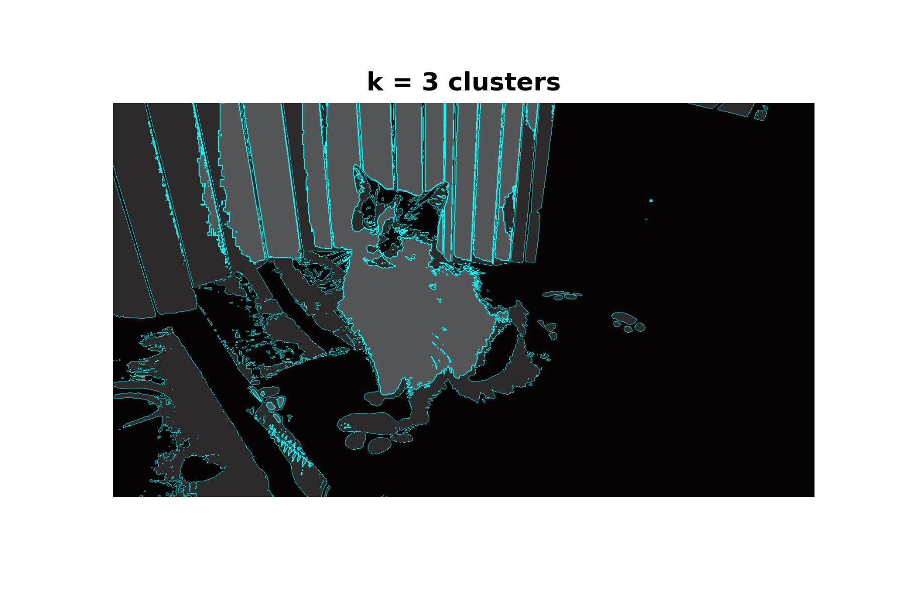
$k$-Means Clustering – Application

Slide 9
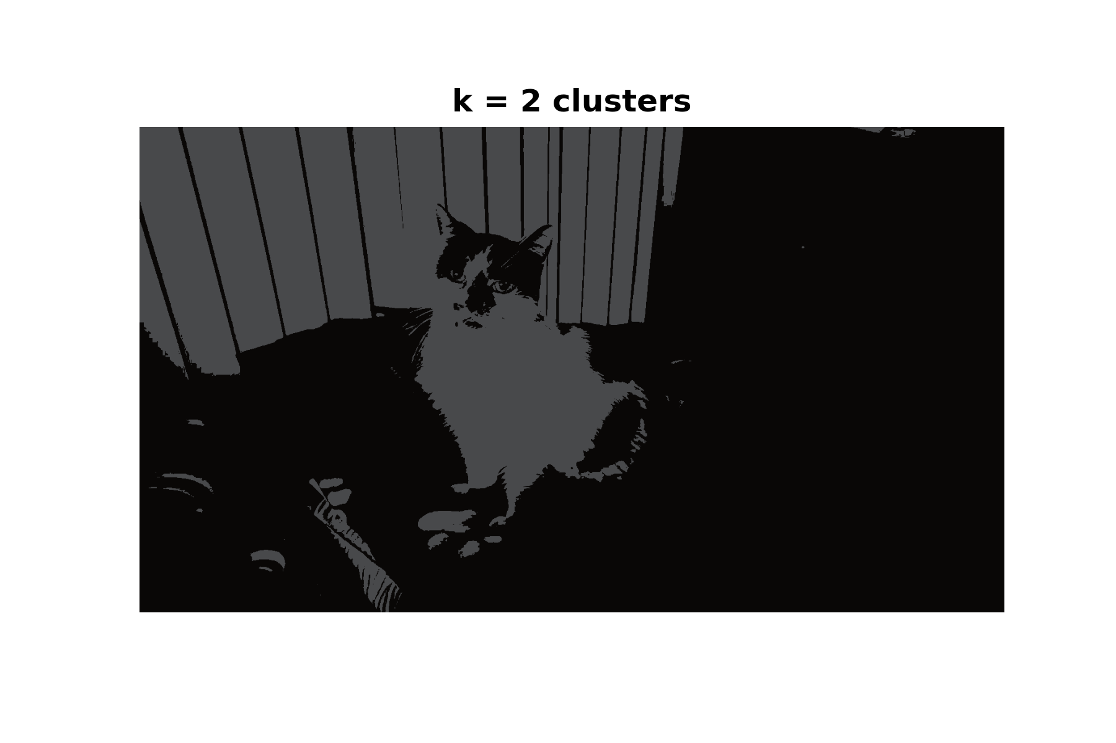
$k$-Means Clustering – Application

Slide 10
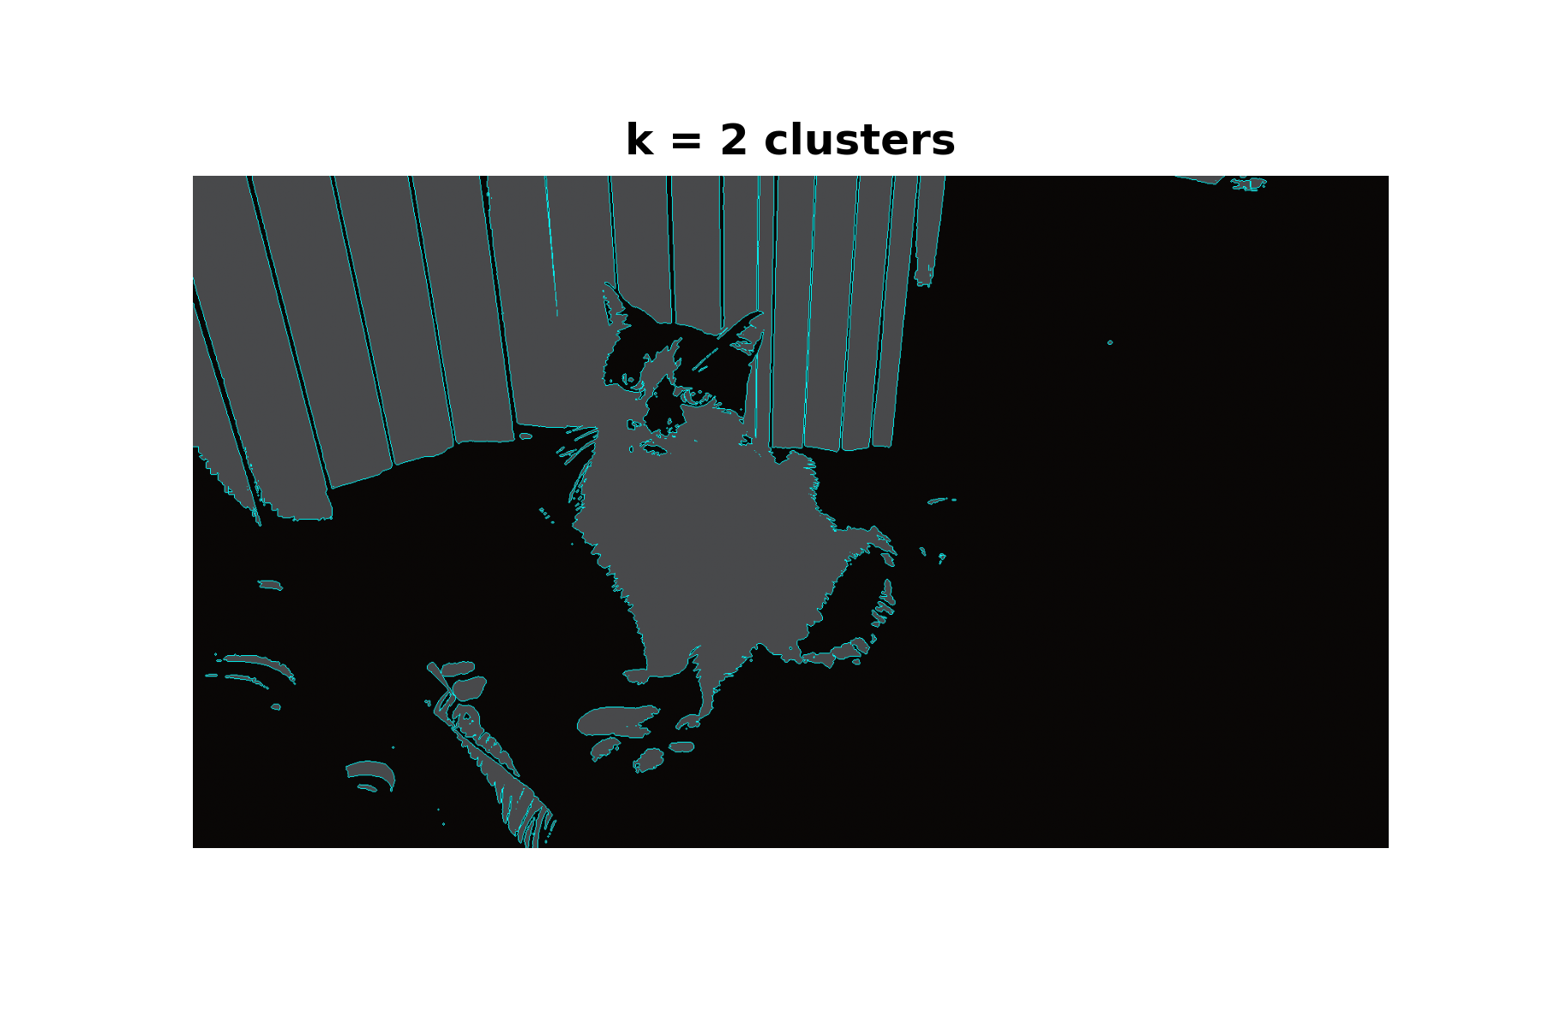
$k$-Means Clustering – Application

Slide 11
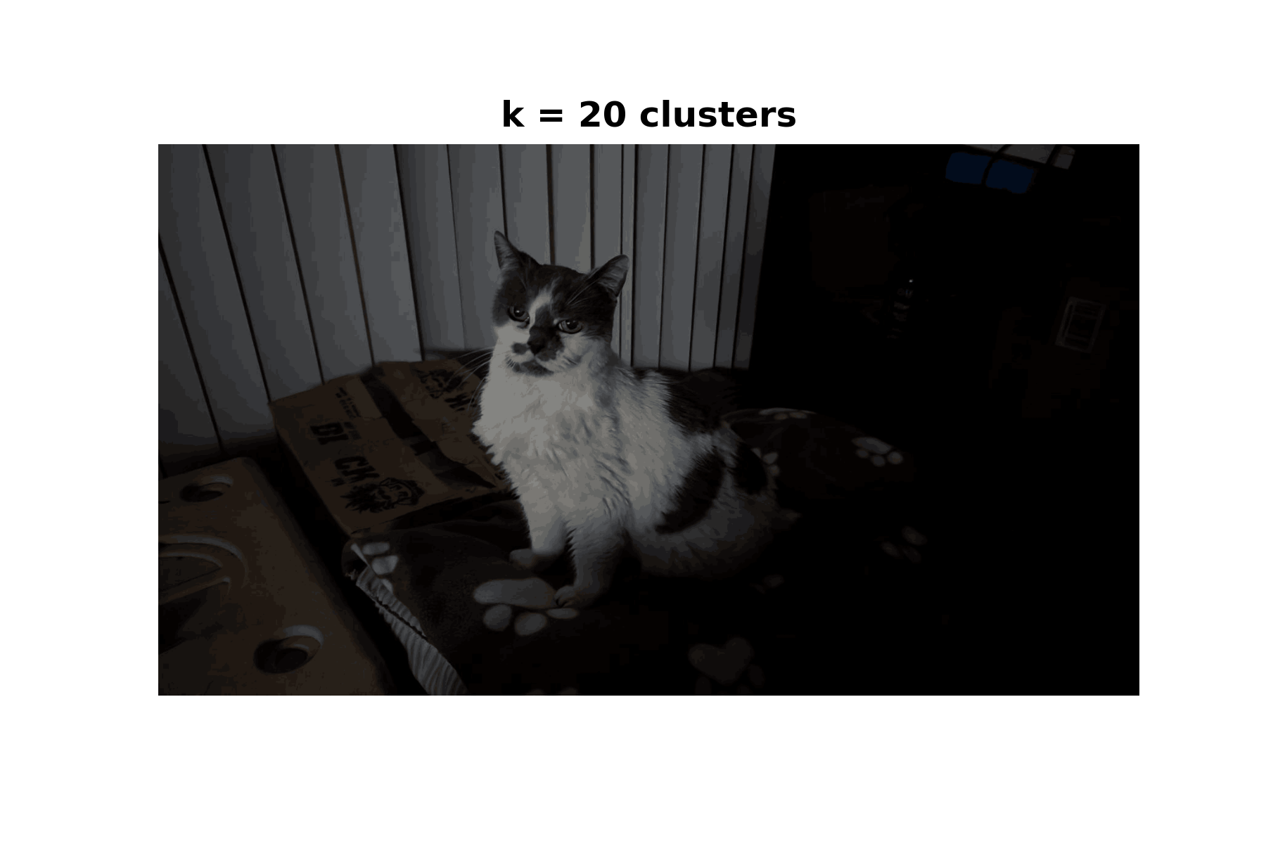
$k$-Means Clustering – Application

Slide 12
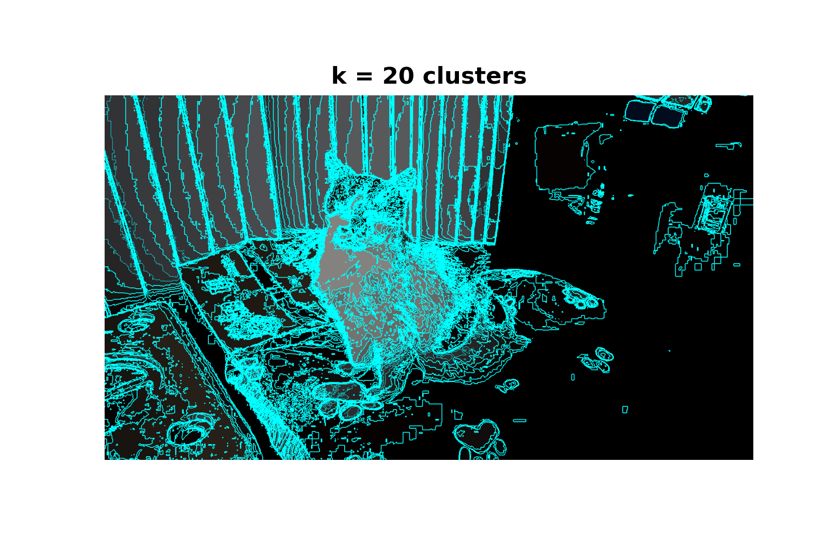
$k$-Means Clustering – Application

Slide 13
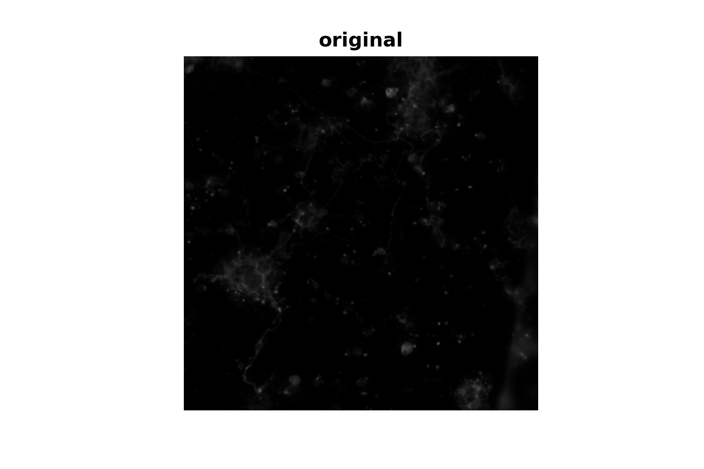

$k$-Means Clustering – Application

Slide 14
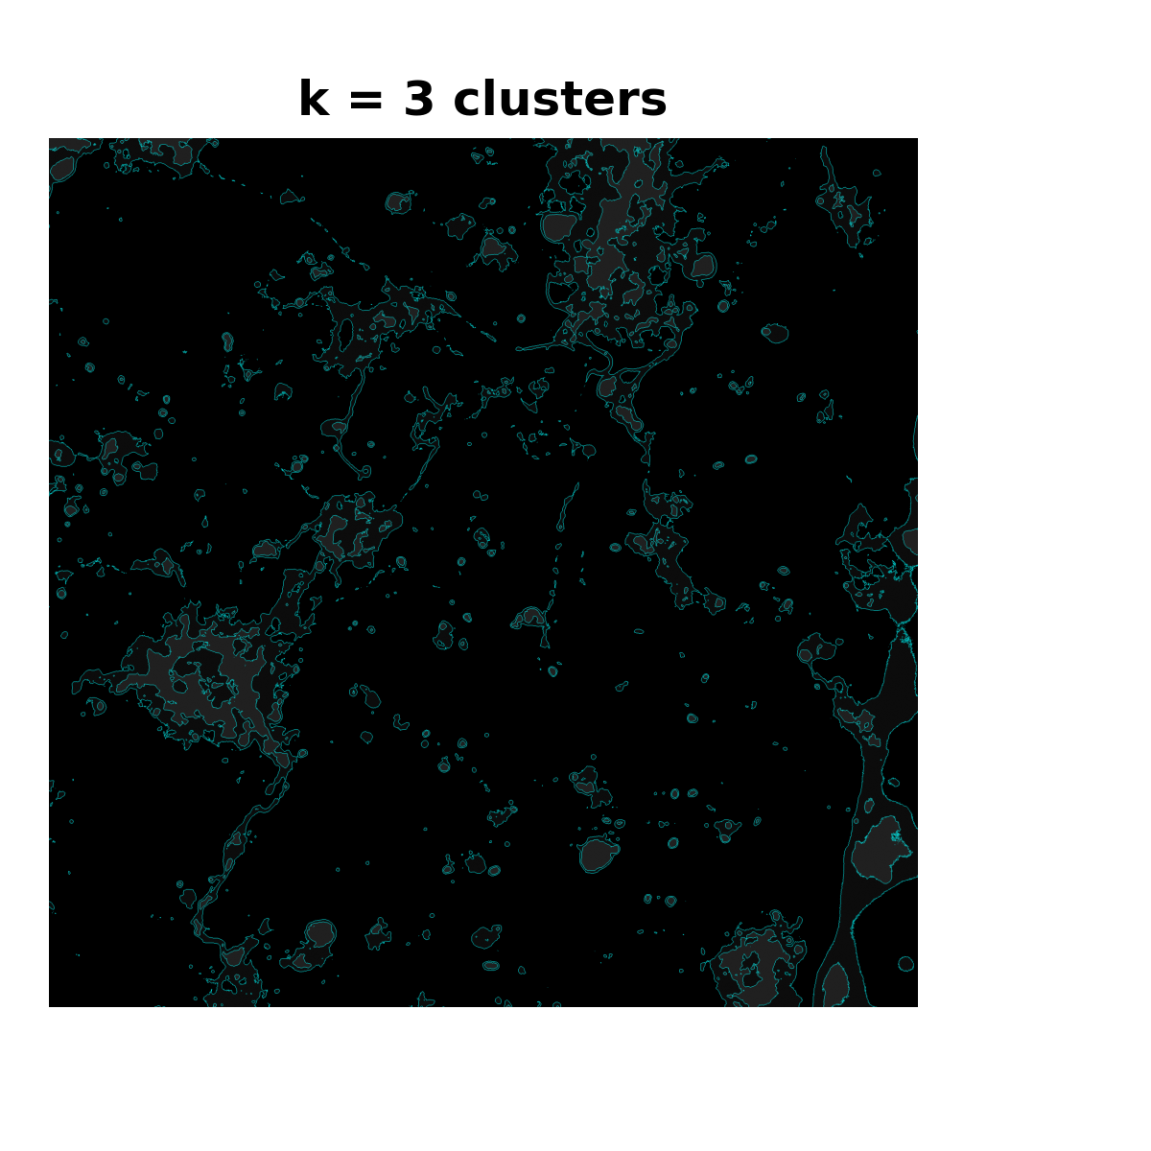
$k$-Means Clustering – Application

Slide 15

$k$-Means Clustering – Application

Slide 16
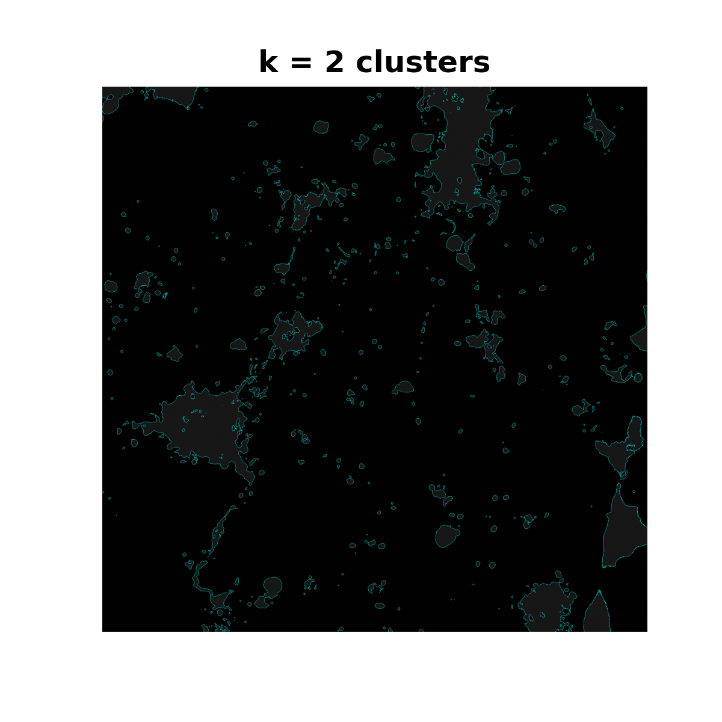
$k$-Means Clustering – Application

Slide 17
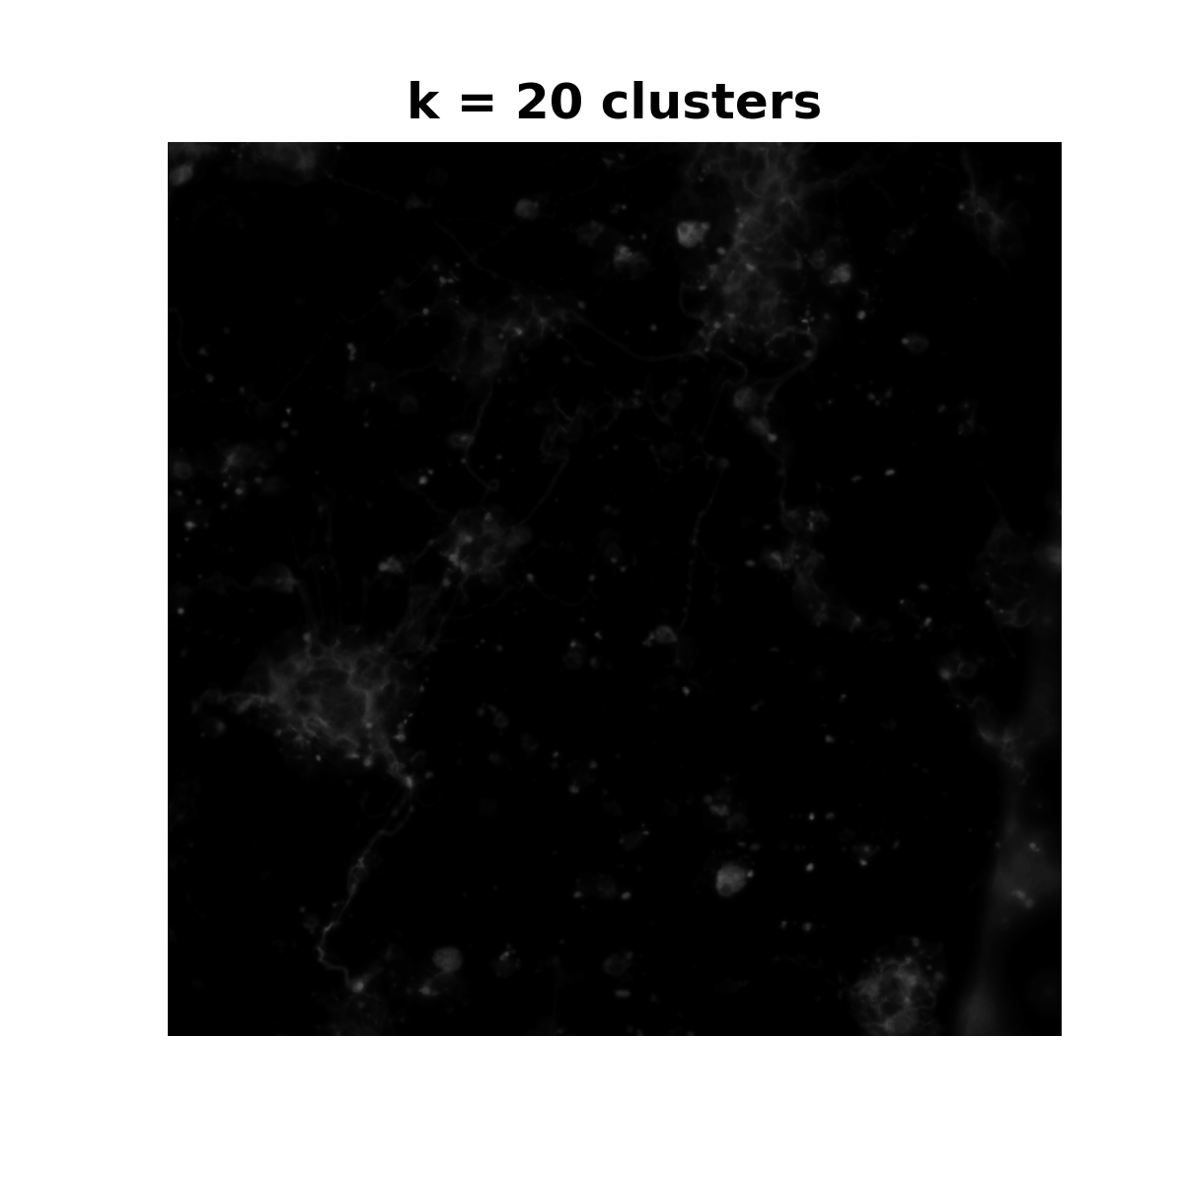
$k$-Means Clustering – Application

Slide 18
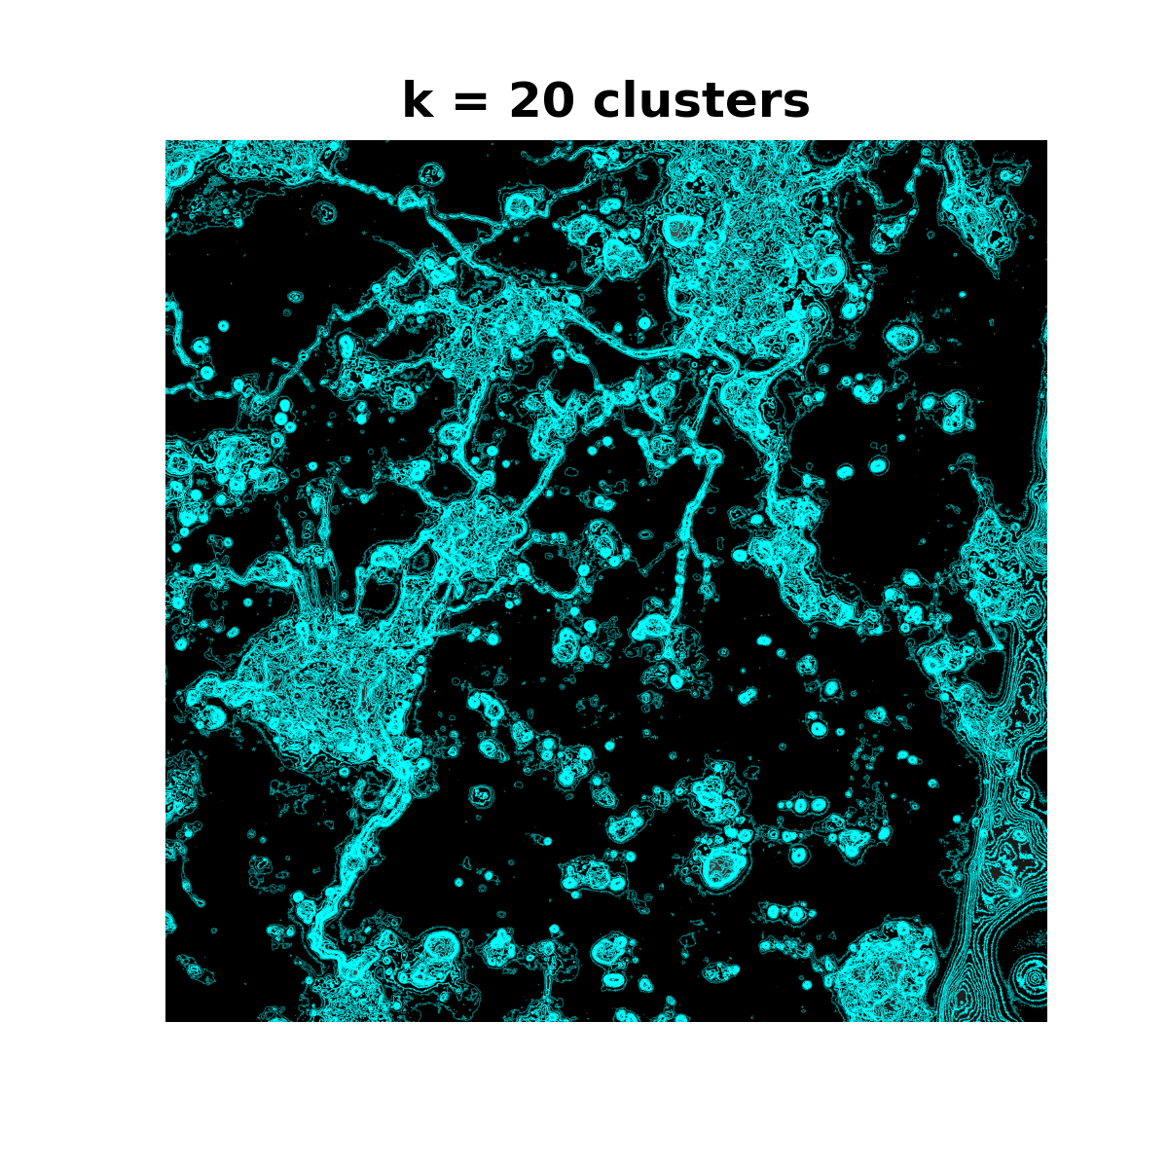
$k$-Means Clustering – Application

Slide 19
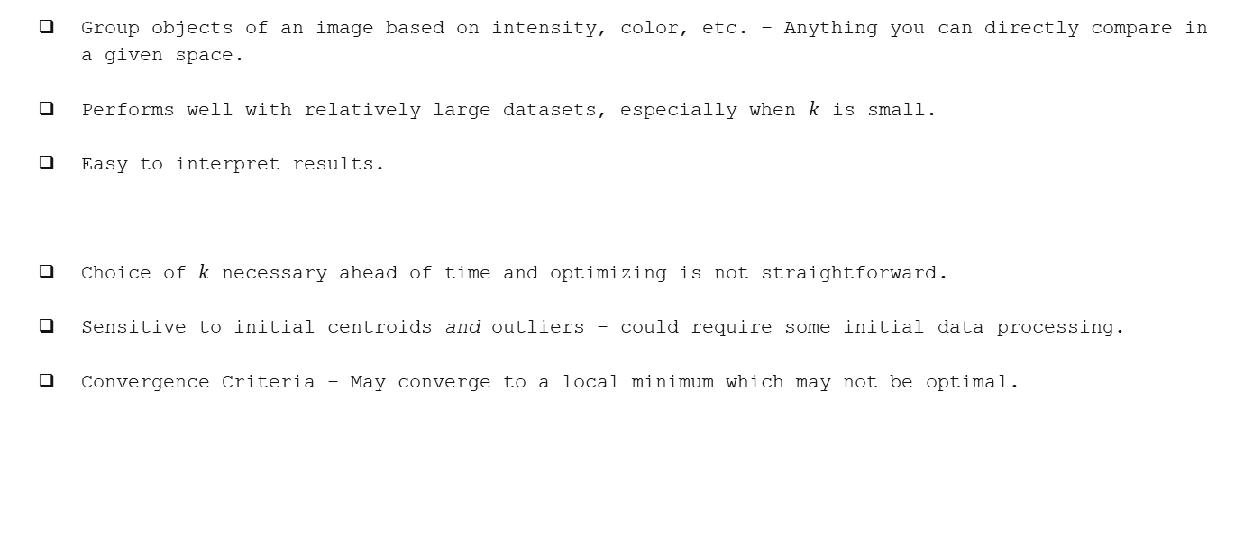
$k$-Means Clustering – (Dis)Advantages
Group objects of an image based on intensity, color, etc. – Anything you can directly compare in a given space.
Performs well with relatively large datasets, especially when $k$ is small.
Easy to interpret results.
Choice of $k$ necessary ahead of time and optimizing is not straightforward.
Sensitive to initial centroids and outliers – could require some initial data processing.
Convergence Criteria – May converge to a local minimum which may not be optimal.

Slide 20
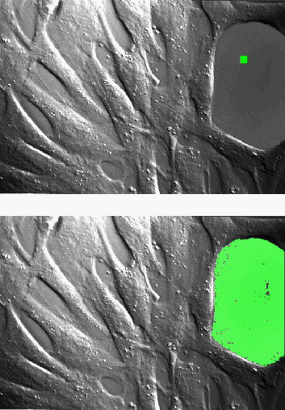
$$Region Growing$$
Start at a point in a region and expand outward within that region.
Process
Choose the initial point (seed) in an image within the area you want to isolate.
Add surrounding pixel RGB values to a queue to be processed.
Compare ‘distance’ of surrounding pixels in RGB-space individually.
If the ‘distance’ is less than a designated threshold, that pixel its surrounding pixels get added to the queue.
If greater, do not add to processing queue.
Repeat!
Note that distance is still the Euclidean metric!
NV5 Geospatial Software Documentation, 2024,
https://nv5geospatialsoftware.com

Slide 22
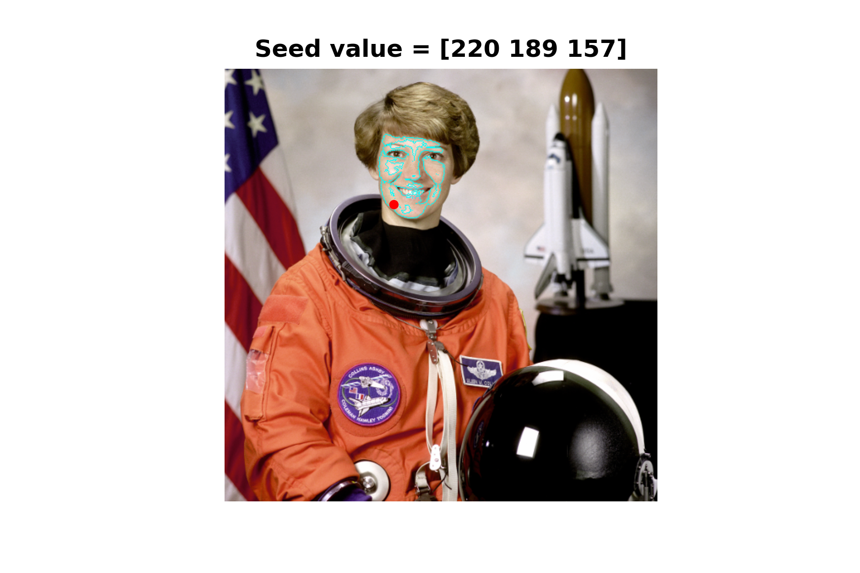
$Region Growth$ – Application

Slide 23
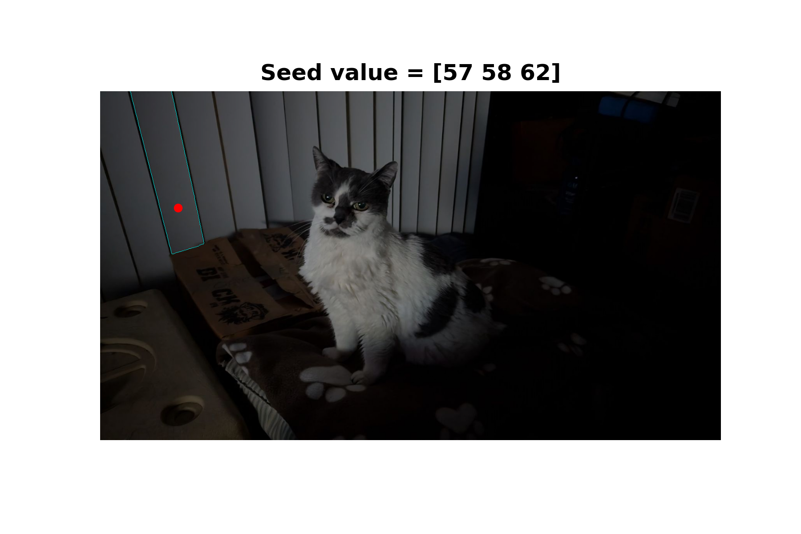
Region Growth – Application

Slide 24

Region Growth – Application

Slide 25
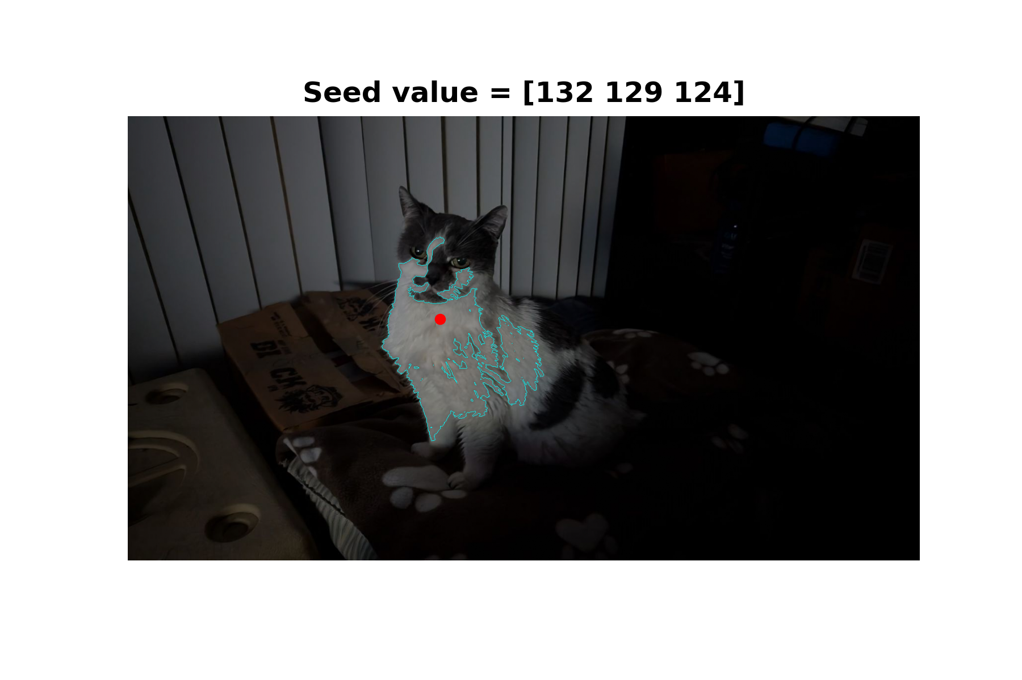
Region Growth – Application

Slide 26

Region Growth – Application

Slide 27
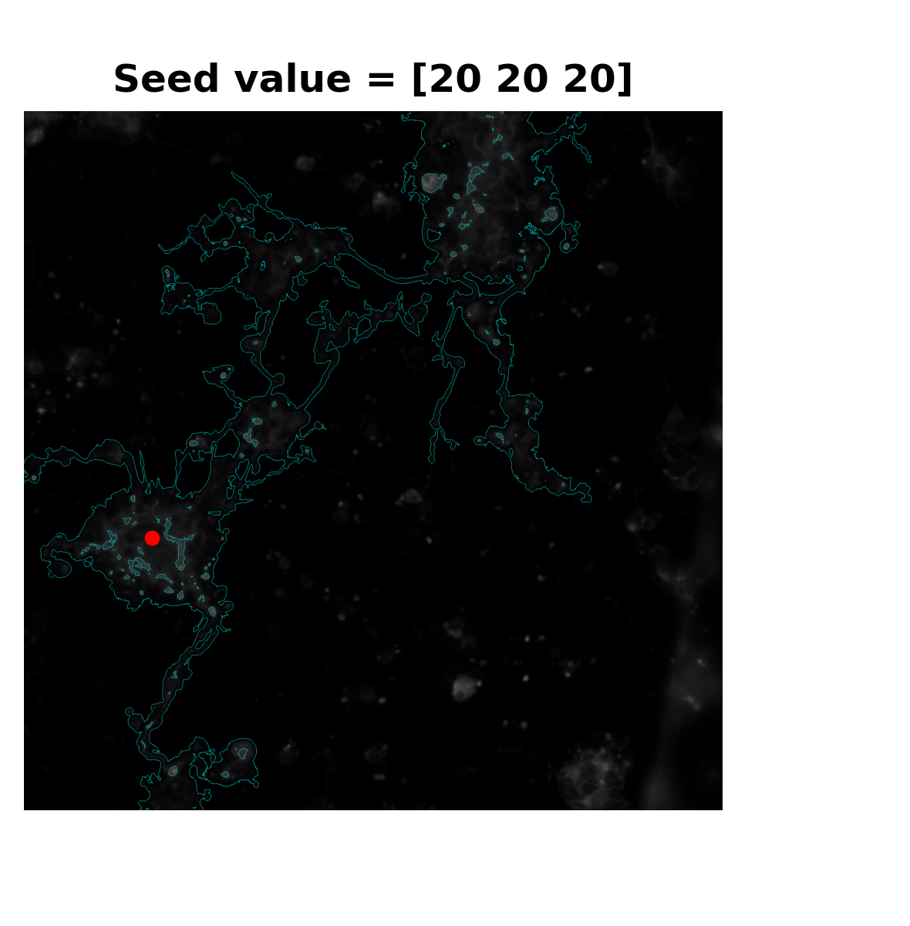
Region Growth – Application
Threshold = 30.0

Slide 28
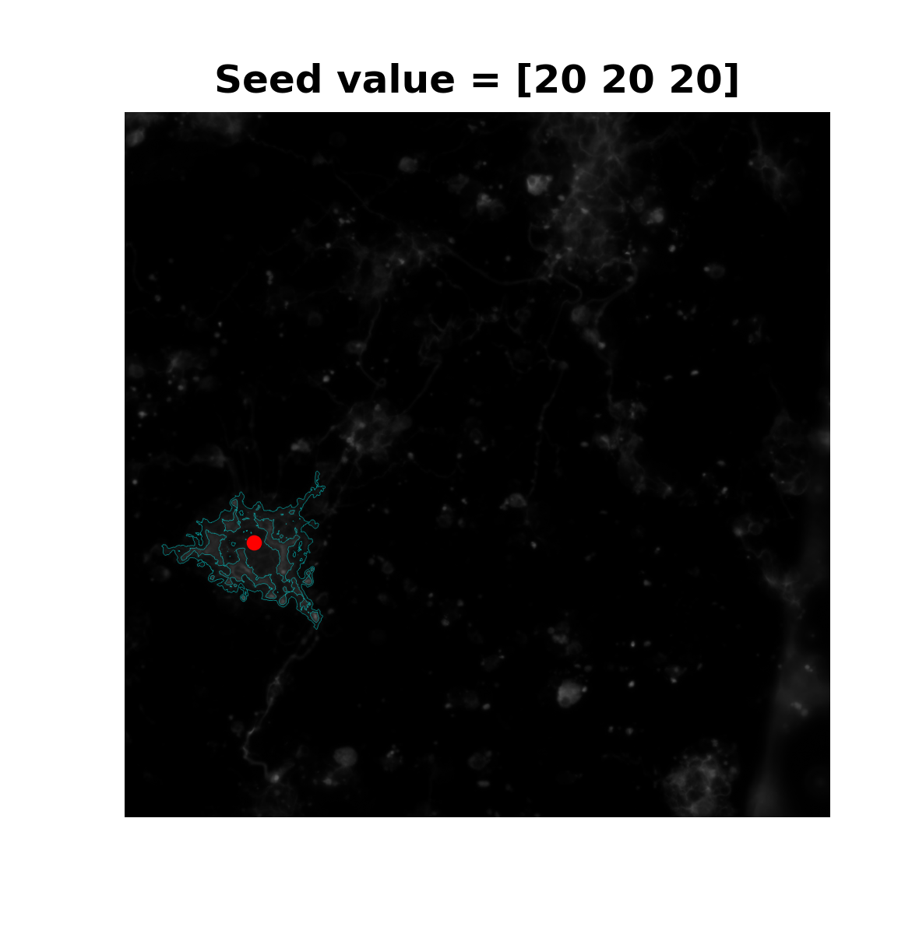
Region Growth – Application
Threshold = 15.0

Slide 29
Region Growth – (Dis)Advantages
Intuitively simple – Start with a seed pixel and choose whether or not to add neighbor pixels based on a criterion determined by the seed.
Contiguous regions – Everything determined to be in a segment are connected based on your criterion
Respects edges
Handles (some) noise fairly well
Highly sensitive to initial seed and threshold
Possibly computationally expensive due to iterative process
Difficulty with complex structures

